Slide 1
Data Mining Classification: Alternative Techniques
Lecture Notes for Chapter 5
Introduction to Data Mining
by
Tan, Steinbach, Kumar
© Tan,Steinbach, Kumar Introduction to Data Mining 4/18/2004 1

Slide 2
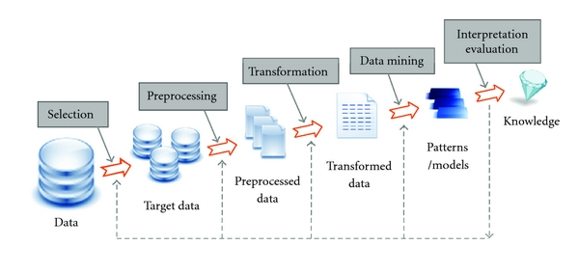
The Knowledge Discovery Process

Slide 3
Nearest Neighbor Classifiers
Basic idea:
If it walks like a duck, quacks like a duck, then it’s probably a duck
Compute Distance
Test Record
Training Records
Choose k of the “nearest” records

Slide 4
Nearest-Neighbor Classifiers
Requires three things
The set of stored records
Distance Metric to compute distance between records
The value of k, the number of nearest neighbors to retrieve
To classify an unknown record:
Compute distance to other training records
Identify k nearest neighbors
Use class labels of nearest neighbors to determine the class label of unknown record (e.g., by taking majority vote)

Slide 5
Definition of Nearest Neighbor
K-nearest neighbors of a record x are data points that have the k smallest distance to x

Slide 6
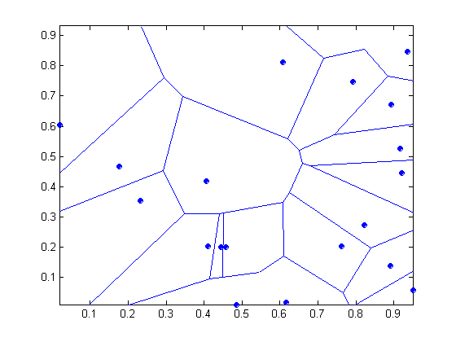
1 nearest-neighbor
Voronoi Diagram

Slide 7
Nearest Neighbor Classification
Compute distance between two points:
Euclidean distance
Determine the class from nearest neighbor list
take the majority vote of class labels among the k-nearest neighbors
Weigh the vote according to distance
weight factor, w = 1/d²

Slide 8
Nearest Neighbor Classification…
Choosing the value of k:
If k is too small, sensitive to noise points
If k is too large, neighborhood may include points from other classes

Slide 9
Classification:
© Tan,Steinbach, Kumar Introduction to Data Mining 4/18/2004 9

Slide 10
Classification: Definition
Given a collection of records (training set )
Each record contains a set of attributes, one of the attributes is the class.
Find a model for class attribute as a function of the values of other attributes.
Goal: previously unseen records should be assigned a class as accurately as possible.
A test set is used to determine the accuracy of the model. Usually, the given data set is divided into training and test sets, with training set used to build the model and test set used to validate it.

Slide 11
Illustrating Classification Task

Slide 12

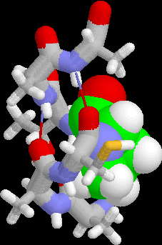
Examples of Classification Task
Predicting tumor cells as benign or malignant
Classifying credit card transactions as legitimate or fraudulent
Classifying secondary structures of protein as alpha-helix, beta-sheet, or random coil
Categorizing news stories as finance, weather, entertainment, sports, etc

Slide 13
Classification Techniques
Decision Tree based Methods

Slide 14
Example of a Decision Tree
categorical
categorical
continuous
class
Splitting Attributes
Refund
Yes
No
NO
MarSt
Single, Divorced
Married
TaxInc
NO
< 80K
> 80K
NO
YES
Training Data
Model: Decision Tree

Slide 15
Another Example of Decision Tree
categorical
categorical
continuous
class
MarSt
Single, Divorced
Married
NO
Refund
Yes
No
NO
TaxInc
< 80K
> 80K
NO
YES
There could be more than one tree that fits the same data!

Slide 16
Decision Tree Classification Task
Decision Tree

Slide 17
Apply Model to Test Data
Test Data
Start from the root of tree.
Refund
Yes
No
NO
MarSt
Single, Divorced
Married
TaxInc
NO
< 80K
> 80K
NO
YES

Slide 18
Apply Model to Test Data
Test Data
Refund
Yes
No
NO
MarSt
Single, Divorced
Married
TaxInc
NO
< 80K
> 80K
NO
YES

Slide 19
Apply Model to Test Data
Test Data
Refund
Yes
No
NO
MarSt
Single, Divorced
Married
TaxInc
NO
< 80K
> 80K
NO
YES

Slide 20
Apply Model to Test Data
Test Data
Refund
Yes
No
NO
MarSt
Single, Divorced
Married
TaxInc
NO
< 80K
> 80K
NO
YES

Slide 21
Apply Model to Test Data
Test Data
Refund
Yes
No
NO
MarSt
Single, Divorced
Married
TaxInc
NO
< 80K
> 80K
NO
YES

Slide 22
Apply Model to Test Data
Test Data
Refund
Yes
No
NO
MarSt
Single, Divorced
Married
Assign Cheat to “No”
TaxInc
NO
< 80K
> 80K
NO
YES

Slide 23
Decision Tree Classification Task
Decision Tree

Slide 24
Decision Tree Induction
Many Algorithms:
Hunt’s Algorithm (one of the earliest)
CART
ID3, C4.5
SLIQ,SPRINT

Slide 25
General Structure of Hunt’s Algorithm
Let D_{t} be the set of training records that reach a node t
General Procedure:
If D_{t} contains records that belong the same class y_{t}, then t is a leaf node labeled as y_{t}
If D_{t} is an empty set, then t is a leaf node labeled by the default class, y_{d}
If D_{t} contains records that belong to more than one class, use an attribute test to split the data into smaller subsets. Recursively apply the procedure to each subset.
D_{t}
?

Slide 26
Hunt’s Algorithm
Refund
Don’t
Cheat
Yes
No
Don’t
Cheat
Don’t
Cheat
Refund
Refund
Yes
No
Yes
No
Don’t
Cheat
Marital
Status
Don’t
Cheat
Marital
Status
Single,
Divorced
Single,
Divorced
Married
Married
Cheat
Don’t
Cheat
Taxable
Income
Don’t
Cheat
< 80K
>= 80K
Don’t
Cheat
Cheat

Slide 27
Tree Induction
Greedy strategy.
Split the records based on an attribute test that optimizes certain criterion.
Issues
Determine how to split the records
How to specify the attribute test condition?
How to determine the best split?
Determine when to stop splitting

Slide 28
Tree Induction
Greedy strategy.
Split the records based on an attribute test that optimizes certain criterion.
Issues
Determine how to split the records
How to specify the attribute test condition?
How to determine the best split?
Determine when to stop splitting

Slide 29
How to Specify Test Condition?
Depends on attribute types
Nominal
Ordinal
Continuous
Depends on number of ways to split
2-way split
Multi-way split

Slide 30
Splitting Based on Nominal Attributes
Multi-way split: Use as many partitions as distinct values.
Binary split: Divides values into two subsets. Need to find optimal partitioning.
CarType
Family
Luxury
Sports
CarType
CarType
{Sports, Luxury}
OR
{Family, Luxury}
{Family}
{Sports}

Slide 31
Splitting Based on Ordinal Attributes
Multi-way split: Use as many partitions as distinct values.
Binary split: Divides values into two subsets. Need to find optimal partitioning.
What about this split?
Size
Small
Large
Medium
Size
Size
{Small, Medium}
OR
{Medium, Large}
{Large}
{Small}
Size
{Small, Large}
{Medium}

Slide 32
Splitting Based on Continuous Attributes
Different ways of handling
Discretization to form an ordinal categorical attribute
Static – discretize once at the beginning
Dynamic – ranges can be found by equal interval bucketing, equal frequency bucketing (percentiles), or clustering.
Binary Decision: (A < v) or (A ≥ v)
consider all possible splits and finds the best cut
can be more compute intensive

Slide 33
Splitting Based on Continuous Attributes

Slide 34
Tree Induction
Greedy strategy.
Split the records based on an attribute test that optimizes certain criterion.
Issues
Determine how to split the records
How to specify the attribute test condition?
How to determine the best split?
Determine when to stop splitting

Slide 35
How to determine the Best Split
Before Splitting: 10 records of class 0, 10 records of class 1
Which test condition is the best?

Slide 36
How to determine the Best Split
Greedy approach:
Nodes with homogeneous class distribution are preferred
Need a measure of node impurity:
Non-homogeneous,
High degree of impurity
Homogeneous,
Low degree of impurity

Slide 37
Measures of Node Impurity
Gini Index
Entropy
Misclassification error

Slide 38
How to Find the Best Split
Before Splitting:
M0
A?
B?
Yes
No
Yes
No
Node N1
Node N2
Node N3
Node N4
M1
M2
M3
M4
M12
M34
Gain = M0 – M12 vs M0 – M34

Slide 39
Measure of Impurity: GINI
Gini Index for a given node t :
(NOTE: p( j | t) is the relative frequency of class j at node t).
Maximum (1 - 1/n_{c}) when records are equally distributed among all classes, implying least interesting information
Minimum (0.0) when all records belong to one class, implying most interesting information

Slide 40
Examples for computing GINI
P(C1) = 0/6 = 0 P(C2) = 6/6 = 1
Gini = 1 – P(C1)² – P(C2)² = 1 – 0 – 1 = 0
P(C1) = 1/6 P(C2) = 5/6
Gini = 1 – (1/6)² – (5/6)² = 0.278
P(C1) = 2/6 P(C2) = 4/6
Gini = 1 – (2/6)² – (4/6)² = 0.444

Slide 41
Splitting Based on GINI
Used in CART, SLIQ, SPRINT.
When a node p is split into k partitions (children), the quality of split is computed as,
where, n_{i} = number of records at child i,
n = number of records at node p.

Slide 42
Binary Attributes: Computing GINI Index
Splits into two partitions
Effect of Weighing partitions:
Larger and Purer Partitions are sought for.
B?
Yes
No
Node N1
Node N2
Gini(N1) = 1 – (5/6)² – (2/6)² = 0.194
Gini(N2) = 1 – (1/6)² – (4/6)² = 0.528
Gini(Children) = 7/12 * 0.194 + 5/12 * 0.528 = 0.333

Slide 43
Categorical Attributes: Computing Gini Index
For each distinct value, gather counts for each class in the dataset
Use the count matrix to make decisions
Multi-way split
Two-way split
(find best partition of values)

Slide 44
Continuous Attributes: Computing Gini Index
Use Binary Decisions based on one value
Several Choices for the splitting value
Number of possible splitting values = Number of distinct values
Each splitting value has a count matrix associated with it
Class counts in each of the partitions, A < v and A ≥ v
Simple method to choose best v
For each v, scan the database to gather count matrix and compute its Gini index
Computationally Inefficient! Repetition of work.

Slide 45
Continuous Attributes: Computing Gini Index...
For efficient computation: for each attribute,
Sort the attribute on values
Linearly scan these values, each time updating the count matrix and computing gini index
Choose the split position that has the least gini index
Sorted Values
Split Positions

Slide 46
Alternative Splitting Criteria based on INFO
Entropy at a given node t:
(NOTE: p( j | t) is the relative frequency of class j at node t).
Measures homogeneity of a node.
Maximum (log n_{c}) when records are equally distributed among all classes implying least information
Minimum (0.0) when all records belong to one class, implying most information
Entropy based computations are similar to the GINI index computations

Slide 47
Examples for computing Entropy
P(C1) = 0/6 = 0 P(C2) = 6/6 = 1
Entropy = – 0 log 0 – 1 log 1 = – 0 – 0 = 0
P(C1) = 1/6 P(C2) = 5/6
Entropy = – (1/6) log₂ (1/6) – (5/6) log₂ (1/6) = 0.65
P(C1) = 2/6 P(C2) = 4/6
Entropy = – (2/6) log₂ (2/6) – (4/6) log₂ (4/6) = 0.92

Slide 48
Splitting Based on INFO...
Information Gain:
Parent Node, p is split into k partitions;
n_{i} is number of records in partition i
Measures Reduction in Entropy achieved because of the split. Choose the split that achieves most reduction (maximizes GAIN)
Used in ID3 and C4.5
Disadvantage: Tends to prefer splits that result in large number of partitions, each being small but pure.

Slide 49
Splitting Based on INFO...
Gain Ratio:
Parent Node, p is split into k partitions
n_{i} is the number of records in partition i
Adjusts Information Gain by the entropy of the partitioning (SplitINFO). Higher entropy partitioning (large number of small partitions) is penalized!
Used in C4.5
Designed to overcome the disadvantage of Information Gain

Slide 50
Splitting Criteria based on Classification Error
Classification error at a node t :
Measures misclassification error made by a node.
Maximum (1 - 1/n_{c}) when records are equally distributed among all classes, implying least interesting information
Minimum (0.0) when all records belong to one class, implying most interesting information

Slide 51
Examples for Computing Error
P(C1) = 0/6 = 0 P(C2) = 6/6 = 1
Error = 1 – max (0, 1) = 1 – 1 = 0
P(C1) = 1/6 P(C2) = 5/6
Error = 1 – max (1/6, 5/6) = 1 – 5/6 = 1/6
P(C1) = 2/6 P(C2) = 4/6
Error = 1 – max (2/6, 4/6) = 1 – 4/6 = 1/3

Slide 52
Misclassification Error vs Gini
A?
Yes
No
Node N1
Node N2
Gini(N1) = 1 – (3/3)² – (0/3)² = 0
Gini(N2) = 1 – (4/7)² – (3/7)² = 0.489
Gini(Children) = 3/10 * 0 + 7/10 * 0.489 = 0.342
Gini improves !!

